Slide 1

AI and the Environment 2:
Linear Regression

Slide 2
Linear Regression
Well here we go getting a little bit more technical thankfully we a linear regression is the easiest form of ML and is a nice simple go to for ML.
If you understand linear regression in statistics it is almost the exact same thing.
Realistically we just use different terminology.

Slide 3
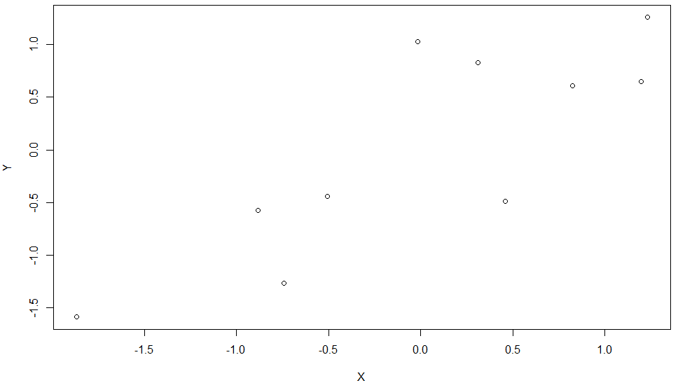
Linear Regression
Lets go over some of the principals of linear regression just in a general statistical point of view.
Lets take a look at a random bunch of data:

Slide 4
Linear Regression
So here we have 10 data point, which isn’t very much but the point of a linear regression is to find the pattern from this data.
The point of finding this pattern is to make predictions about the relationship between X and Y.

Slide 5
Linear Regression
The point of finding this pattern is to make predictions about the relationship between X and Y.
Making a prediction about something is exactly what ML is meant to do so linear Regression is a nice simple way to do it.

Slide 6
Linear Regression
So when we are looking at an explanatory variable and a predictor variable what do we do to try and get a prediction based on any explanatory input?
Well it’s in the name… Draw a line.

Slide 7
Linear Regression
So when we are looking at an explanatory variable and a predictor variable what do we do to try and get a prediction based on any explanatory input?
Well it’s in the name… Draw a line.

Slide 8
Linear Regression
How do we describe a line with Maths?

Slide 9
Linear Regression
How do we describe a line with Maths?
A line is a vector – It describes the movement between two locations in “space”

Slide 10
Linear Regression
How do we describe a line with Maths?
A line is a vector – It describes the movement between two locations in “space”

Slide 11
Linear Regression
A line is a vector – It describes the movement between two locations in “space”
What movement does this vector describe?

Slide 12
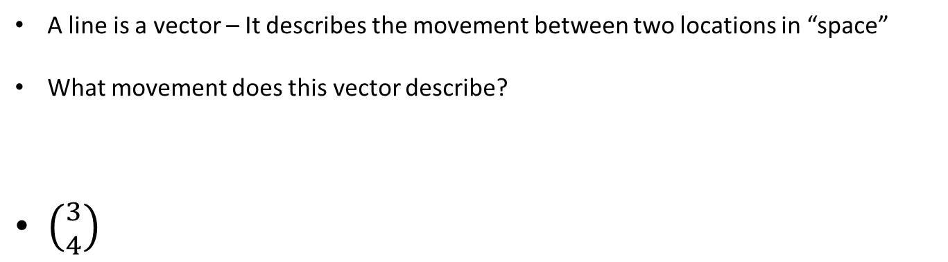
Linear Regression
A line is a vector – It describes the movement between two locations in “space”
What movement does this vector describe?
$\left({3 \atop 4}\right)$

Slide 13
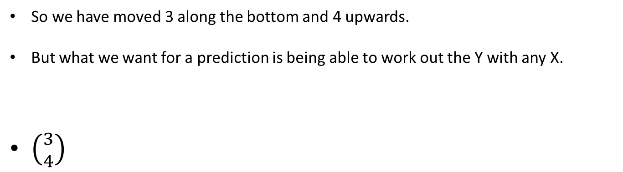
Linear Regression
So we have moved 3 along the bottom and 4 upwards.
But what we want for a prediction is being able to work out the Y with any X.
$\left({3 \atop 4}\right)$

Slide 14
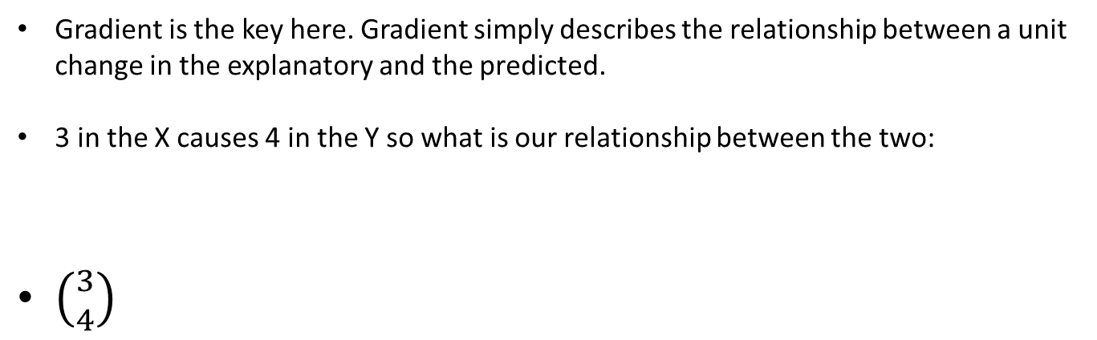
Linear Regression
Gradient is the key here. Gradient simply describes the relationship between a unit change in the explanatory and the predicted.
3 in the X causes 4 in the Y so what is our relationship between the two:
$\left({3 \atop 4}\right)$

Slide 15
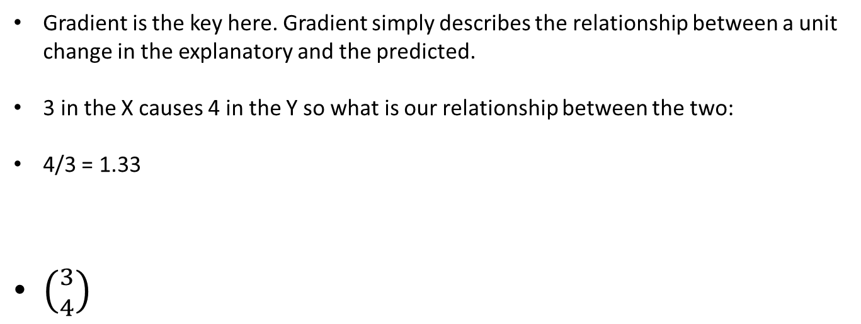
Linear Regression
Gradient is the key here. Gradient simply describes the relationship between a unit change in the explanatory and the predicted.
3 in the X causes 4 in the Y so what is our relationship between the two:
4/3 = 1.33
$\left({3 \atop 4}\right)$

Slide 16
Linear Regression
So we can use a line to make a prediction based on a given input by calculating the gradient of a line.
This gradient is calculated as the ratio between Y/X so if we call this gradient m
m = Y/X

